Slide 1

Street Friends By: Jose Trochez COM-437-OL01 MOBIle Application Development

Slide 2

Project Description
Street Friends is a mobile application designed to help people get in touch with their neighbors based on their residential addresses. The app allows its users to engage in conversations and foster a stronger sense of community. With a focus on safety and privacy, Street Friends ensures that users can interact with confidence, making their local area feel more like a family.

Slide 3

Problem Addressing
Street Friends helps users take the first step in virtually getting to know their neighbors. The app helps neighbors organize gatherings and events and share information securely.
Front/Back-end Support
Front-end: Adalo’s built-in tools for UI design. Adalo's front-end is based on React.
Back-end: The database is managed by Adalo’s back-end services.
Adalo's back-end is based on a mix of technologies but primarily Node.js.
Security
Street Friends will implement standard security measures, such as HTTPS, data encryption, and user authentication, which are provided by Adalo.

Slide 4
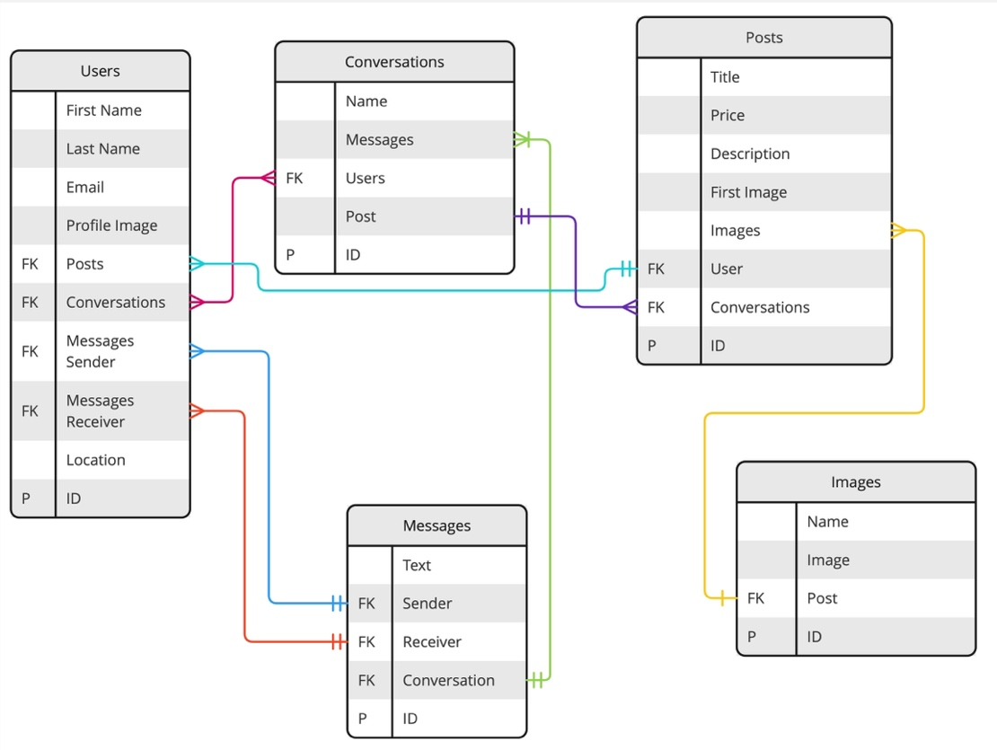
Platform
Data Structure
Street Friends is available as the following:
Mobile Application
Web Application

Slide 5
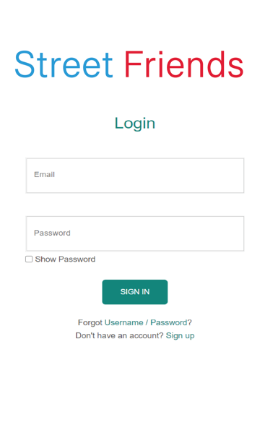
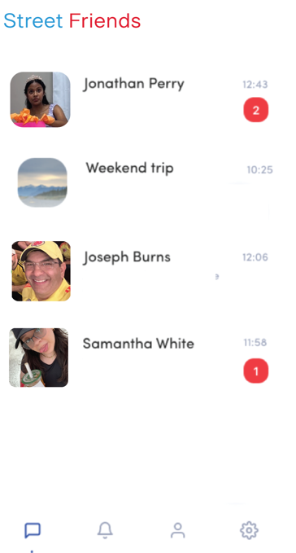
Design (Wireframes)
Login
Communication Chat

Slide 6

Navigation Methodology (User Interface)
Homepage Navigation: Users access the key sections via the main menu and search bar.
User Authentication: Signup/Login options provide for account access.
Browsing: Users browse, filter, and view posts shared by other users near their neighborhood.
Posting: Users easily post stories with their neighbors guided by app submission.
Profile Page: Users can view other users’ posts.
Messaging System: Users communicate with friends via inbox.
Account Management: Users access profile settings and history.

Slide 7

Functionality
User Authentication: Feature ensures that only users with verified location can access the site.
Discovering: Feature allows users to browse and contact their local neighbors based on their location.
Posting: Allows users to upload pictures of the memories they want to share with their neighbors.
Messaging System: Facilitate communications between users.

Slide 8

Core Application Standards
Usability: The application is reliable and user-friendly.
Compatibility: The application is compatible with the latest phones.
Performance: The application performs well under load with multiple users and stress.
Security: Personal information, communication, and transactions are secure.

Slide 9
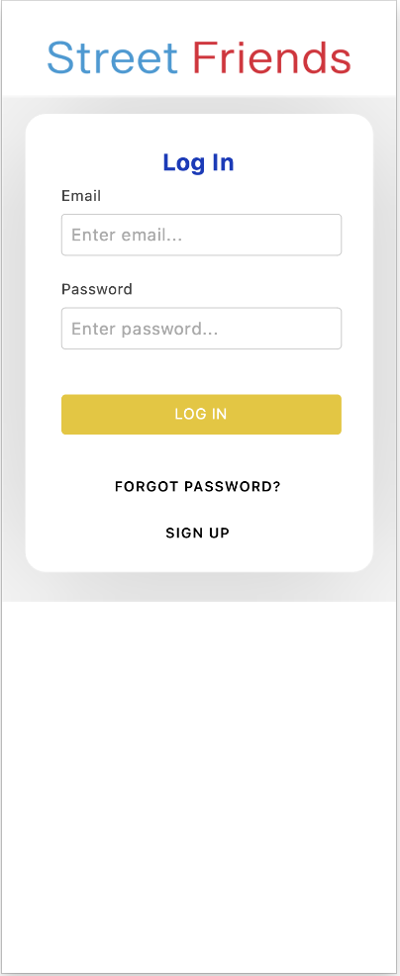
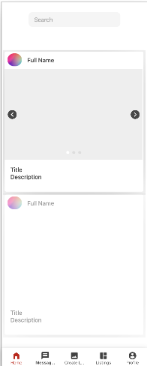
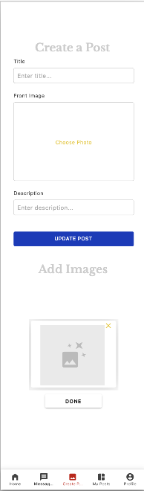
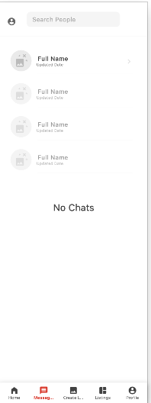
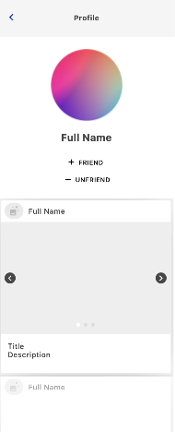
Final Desings

Slide 10

Github
https://github.com/Trochej15/Street-Friends?tab=readme-ov-file#street-friends

